Slide 1
Podcast Plus: A Redux-Inspired Podcast App With Dynamic Themes For Android

Slide 2
Discover, download, and enjoy your favorite podcasts with Podcast Plus, a feature-rich Android app inspired by Redux principles. Personalize your listening experience with dynamic themes, intuitive discovery, and seamless playback.Key Features:- Dynamic Themes: Choose from various themes or create custom ones- Podcast Discovery: Browse top charts, categories, and recommendations- Offline Playback: Listen anywhere, anytime- Multi-Tab Support: Organize podcasts into custom tabs- Episode Notifications: Stay updated on new releases- Search and Filtering: Quick access to specific podcasts or episodesDesigned for You:- User-friendly interface- Customizable font sizes and styles- Secure data storage and encryption- Battery-efficient playback

Slide 3
package com.example.podcastplayer
import android.content.Context
import android.media.MediaPlayer
import android.os.Bundle
import androidx.activity.ComponentActivity
import androidx.activity.compose.setContent
import androidx.compose.foundation.BorderStroke
import androidx.compose.foundation.Image
import androidx.compose.foundation.layout.*
import androidx.compose.foundation.rememberScrollState
import androidx.compose.foundation.verticalScroll
import androidx.compose.material.*
import androidx.compose.runtime.*
import androidx.compose.ui.Alignment
import androidx.compose.ui.Modifier
import androidx.compose.ui.graphics.Color
import androidx.compose.ui.res.painterResource
import androidx.compose.ui.text.font.FontWeight
import androidx.compose.ui.text.style.TextAlign
import androidx.compose.ui.unit.dp
import androidx.compose.ui.unit.em
import androidx.compose.ui.unit.sp
import com.example.podcastplayer.ui.theme.PodcastPlayerTheme

Slide 4
class MainActivity : ComponentActivity() {
override fun onCreate(savedInstanceState: Bundle?) {
super.onCreate(savedInstanceState)
setContent {
PodcastPlayerTheme {
// A surface container using the 'background' color from the theme
Surface(
modifier = Modifier.fillMaxSize(),
color = MaterialTheme.colors.background
) {
playAudio(this)
}
}
}
}
}

Slide 5
@Composable
fun playAudio(context: Context) {
Column(modifier = Modifier.fillMaxSize()) {
Column(horizontalAlignment = Alignment.CenterHorizontally, verticalArrangement = Arrangement.Center) {
Text(text = "PODCAST",
modifier = Modifier.fillMaxWidth(),
textAlign = TextAlign.Center,
color = Color(0xFF6a3ef9),
fontWeight = FontWeight.Bold,
fontSize = 36.sp,
style = MaterialTheme.typography.h1,
letterSpacing = 0.1.em
)
}
Column(modifier = Modifier
.fillMaxSize()
.verticalScroll(rememberScrollState())) {
Card(
elevation = 12.dp,
border = BorderStroke(1.dp, Color.Magenta),
modifier = Modifier
.padding(16.dp)
.fillMaxWidth()
.height(250.dp)
)

Slide 6
{
val mp: MediaPlayer = MediaPlayer.create(context, R.raw.audio)
Column(
modifier = Modifier.fillMaxSize(),
horizontalAlignment = Alignment.CenterHorizontally
) {
Image(
painter = painterResource(id = R.drawable.img),
contentDescription = null,
modifier = Modifier
.height(150.dp)
.width(200.dp),
)
Text(
text = "GaurGopalDas Returns To TRS - Life, Monkhood & Spirituality",
textAlign = TextAlign.Center,
modifier = Modifier.padding(start = 20.dp, end = 20.dp)
)
Row() {
IconButton(onClick = { mp.start() }, modifier = Modifier.size(35.dp)) {
Icon(
painter = painterResource(id = R.drawable.play),
contentDescription = ""
)
}

Slide 7
IconButton(onClick = { mp.pause() }, modifier = Modifier.size(35.dp)) {
Icon(
painter = painterResource(id = R.drawable.pause),
contentDescription = ""
)
}
}
}
}

Slide 8
Card(
elevation = 12.dp,
border = BorderStroke(1.dp, Color.Magenta),
modifier = Modifier
.padding(16.dp)
.fillMaxWidth()
.height(250.dp)
)
{
val mp: MediaPlayer = MediaPlayer.create(context, R.raw.audio_1)
Column(
modifier = Modifier.fillMaxSize(),
horizontalAlignment = Alignment.CenterHorizontally
) {
Image(
painter = painterResource(id = R.drawable.img_1),
contentDescription = null,
modifier = Modifier
.height(150.dp)
.width(200.dp)
)
Text(
text = "Haunted Houses, Evil Spirits & The Paranormal Explained | Sarbajeet Mohanty",
textAlign = TextAlign.Center,
modifier = Modifier.padding(start = 20.dp, end = 20.dp)
)

Slide 9
Row() {
IconButton(onClick = { mp.start() }, modifier = Modifier.size(35.dp)) {
Icon(
painter = painterResource(id = R.drawable.play),
contentDescription = ""
)
}

Slide 10
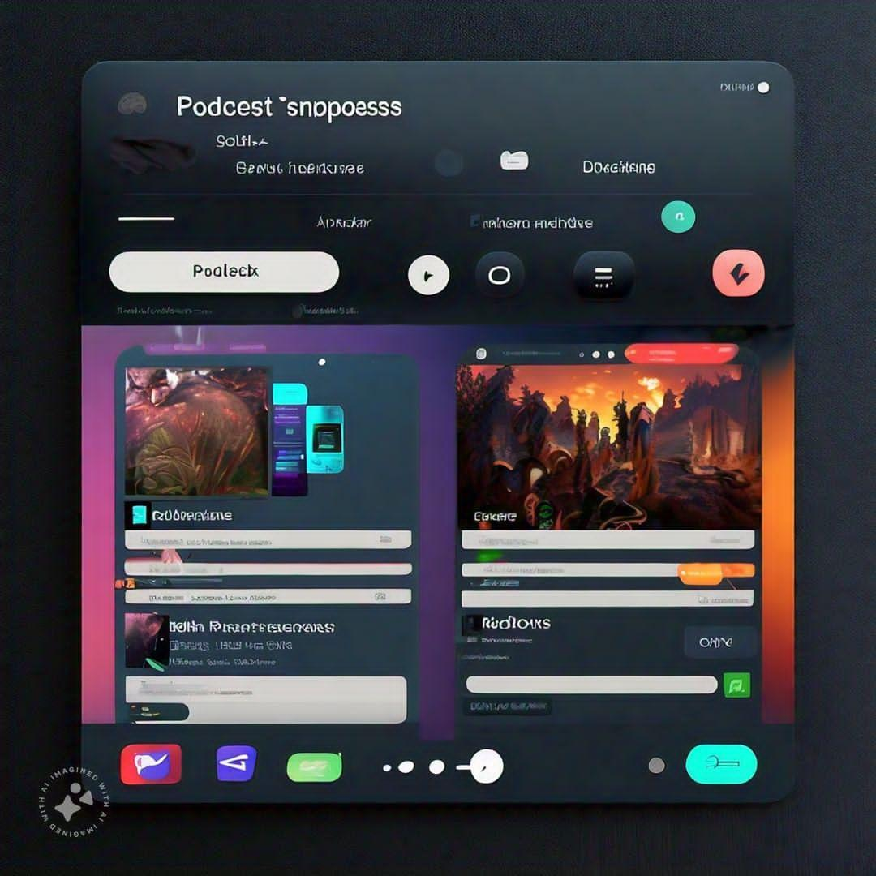
Output:

